Slide 1
Mobile Application Development - Day 10
ViewPager
Toolbar
Theme

Slide 2
ViewPager
Layout manager that allows the user to flip left and right through pages of data
ViewPager is most often used in conjunction with Fragment
There are standard adapters implemented for using fragments with the ViewPager
FragmentPagerAdapter
Use this when navigating between a fixed, small number of sibling screens.
FragmentStatePagerAdapter
Use this when paging across an unknown number of pages.

Slide 3
ViewPager
<androidx.viewpager.widget.ViewPager
xmlns:android="http://schemas.android.com/apk/res/android"
android:id="@+id/pager"
android:layout_width="match_parent"
android:layout_height="match_parent" />

Slide 4
ViewPage with TabLayout
<androidx.viewpager.widget.ViewPager
xmlns:android="http://schemas.android.com/apk/res/android"
android:id="@+id/pager"
android:layout_width="match_parent"
android:layout_height="match_parent">
<com.google.android.material.tabs.TabLayout
android:id="@+id/tab_layout"
android:layout_width="match_parent"
android:layout_height="wrap_content" />
</androidx.viewpager.widget.ViewPager>

Slide 5
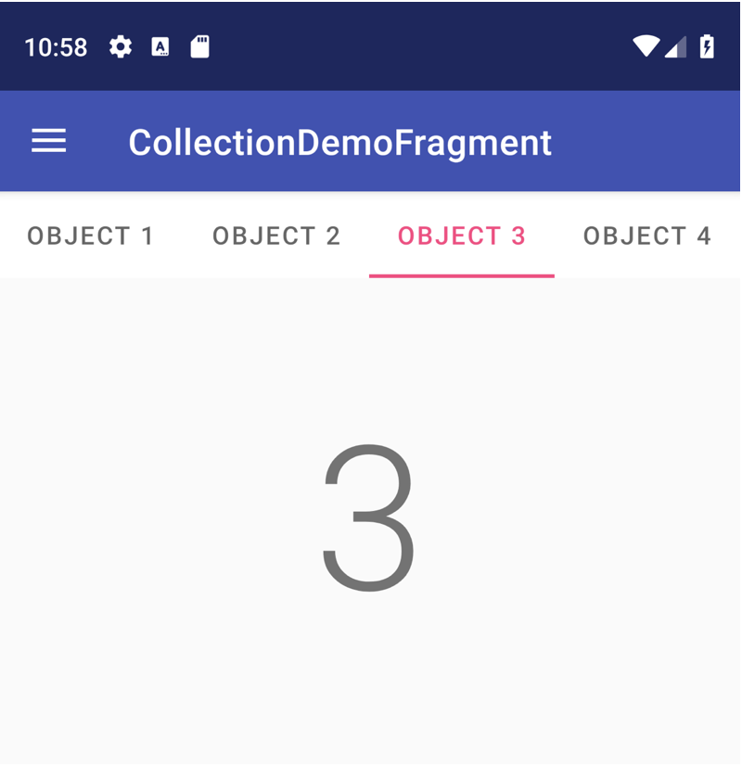
ViewPager with TabLayout

Slide 6
Toolbar
Toolbar was introduced in Android Lollipop, API 21 release
successor of the ActionBar
Required dependency
implementation 'androidx.appcompat:appcompat:1.0.0'
Toolbar can be set from
XML
Theme

Slide 7
Toolbar -XML
<LinearLayout xmlns:android="http://schemas.android.com/apk/res/android"
……..>
<androidx.appcompat.widget.Toolbar
android:id="@+id/toolbar"
android:minHeight="?attr/actionBarSize"
android:layout_width="match_parent"
android:layout_height="wrap_content"
app:titleTextColor="@android:color/white"
android:background="?attr/colorPrimary">
</androidx.appcompat.widget.Toolbar>
</LinearLayout>

Slide 8
Toolbar - Theme
<resources>
<style name="AppTheme" parent="Theme.AppCompat.Light.NoActionBar">
</style>
</resources>

Slide 9
Toolbar - Custom
Toolbar toolbar = (Toolbar) findViewById(R.id.toolbar);
setSupportActionBar(toolbar);
// Remove default title text
getSupportActionBar().setDisplayShowTitleEnabled(false);
// Get access to the custom title view
TextView mTitle = (TextView) toolbar.findViewById(R.id.toolbar_title);

Slide 10
Sample Question
Explain Viewpager.
Explain toolbar.
Short notes:
Custom Toolbar
TabLayout

